Slide 1







Crafting Compelling Website Analysis and Audit Recommendations
This presentation provides an in-depth analysis of website strengths and weaknesses, offering actionable recommendations for improvements while highlighting IBM's technology and services to enhance user experience and avoid common pitfalls.
Surya Prakash
Presenter

Slide 2






Comprehensive Overview of IBM's Services and Innovations
Explore IBM's contributions to technology, AI, and digital transformation
Global Technology Leader
Artificial Intelligence Focus
Cybersecurity and Data Analytics
Pioneers in Mainframe Development
IBM (International Business Machines Corporation) is a prominent global technology and consulting company based in Armonk, New York, providing innovative solutions worldwide.
IBM offers advanced services in artificial intelligence, prominently featuring its Watson platform, which enhances decision-making and operational efficiency for businesses.
The company specializes in cybersecurity and data analytics, equipping organizations with tools to protect data and derive insights for better strategies.
IBM has been instrumental in the evolution of mainframe computers and continues to support enterprise clients with cutting-edge technology and digital transformation services.

Slide 3


Overview of IBM Products and Services
Explore the range of hardware and software offerings from IBM
IBM Hardware
IBM Z Series
IBM Power Systems
IBM Software
IBM Watson
IBM QRadar
Watson Studio

Slide 4


Comprehensive Website Platform Analysis
An in-depth examination of website platforms, including CMS, analytics, frameworks, and hosting options.
CMS
Analytics
Web Framework
Hosting & Servers
Anchor CMS
Ruxit
Bootstrap 4.4.1
Amazon S3
Dynatrace RUM
Hotjar
Java Servlet 3.1
Google Cloud
Semantic UI
Apache 2.4.6
Microsoft ASP.NET 4.0.30319
Nginx 1.24.0
IIS 10.1

Slide 5

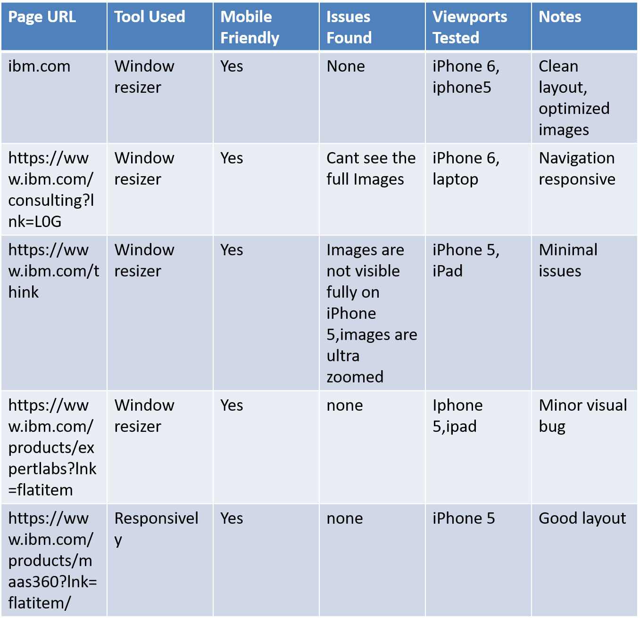
Responsive Design Testing

Slide 6
Effective Strategies for Responsive Design Testing
✅ All tested pages are mobile-friendly.
🔍 Minor issues on small or foldable screens:
- Font scaling and layout overlap.
- Slight navbar delay on some devices.
🛠 No major usability or speed issues detected.
📱 Good performance across various viewports.

Slide 7

Identifying Common Website Mistakes for Improvement
A detailed examination of frequent website pitfalls that hinder user experience and SEO performance.
Cluttered Navigation and Excessive CTAs
Overloaded top navigation and homepage confuse user.
Impact:making it difficult to focus on essential actions.
Impact of Slow Loading Times
Heavy multimedia content slows down pages, negatively
Impact: user retention and search engine rankings and increase bounce rates.
Critical Page Speed Metrics
With a desktop page speed of 17, significant improvements are needed for enhanced
Impact: affects both user experience and SEO.
Mobile Responsiveness Challenges
Failure to properly render interactive features on mobile leads to increased user frustration and disengagement.

Slide 8




Key Strategies for Effective Website Optimization
Enhance website performance and user experience through optimization techniques
Compress Images Effectively
Simplify Navigation Structure
Utilize Lazy Loading Techniques
Optimize for Mobile Responsiveness
Utilize image compression techniques to reduce file sizes, improving page load speed and overall performance.
Organize similar content to create a user-friendly navigation experience while reducing the number of CTAs on each page.
Implement lazy loading for images and videos to defer loading until they are in the viewport, enhancing initial load times.
Leverage responsive design testing tools to address layout shifting and ensure appropriate tap target spacing for mobile users.

Slide 9
LANDING PAGE DESIGN
.
LINK OF MY LANDING PAGE DESIGN: https://suryadm.my.canva.site/

Slide 10








Essential Elements of Effective Landing Page Design
Understanding the critical components that enhance user engagement and conversion rates
Importance of a well-designed landing page.
Utilization of Canva for design.
Focus on conversion rates.
Incorporating call-to-action elements.
Canva provides user-friendly tools that simplify the creation of visually appealing landing pages without extensive design skills.
The primary goal of a landing page is to optimize conversion rates by compelling visitors to take specific actions.
A landing page is vital in transforming casual visitors into potential customers, playing a pivotal role in digital marketing.
Effective landing pages prominently feature clear call-to-action buttons to guide users toward the desired outcome.
Need for concise messaging.
Analyzing user experience.
Employing visual hierarchy.
Clear and concise messaging is essential to communicate the value proposition quickly to visitors, ensuring engagement.
A well-structured landing page enhances user experience, encouraging visitors to explore further and complete desired actions.
Effective use of visual hierarchy helps direct attention to critical information, ensuring visitors grasp key messages promptly.

Slide 11




Take Action Now: Elevate Your Website's Performance
Assess your website's current performance to identify areas for improvement. Implement the recommended best practices to enhance user experience, boost engagement, and ultimately drive conversions effectively and efficiently.

